Slide 1

The Art of Powerful Questions
http://www.flickr.com/photos/drachmann/327122302/sizes/l/

Slide 2
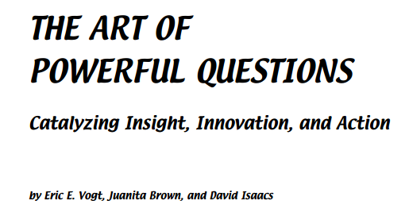
The Art of Powerful Questions
Whole Systems Associates www.theworldcafe.com

Slide 3

“A paradigm shift occurs when a question is asked inside the Current paradigm that can only be answered from outside it”
The Art of the Question, Marilee Goldberg
http://www.flickr.com/photos/oberazzi/318947873/sizes/l/

Slide 4
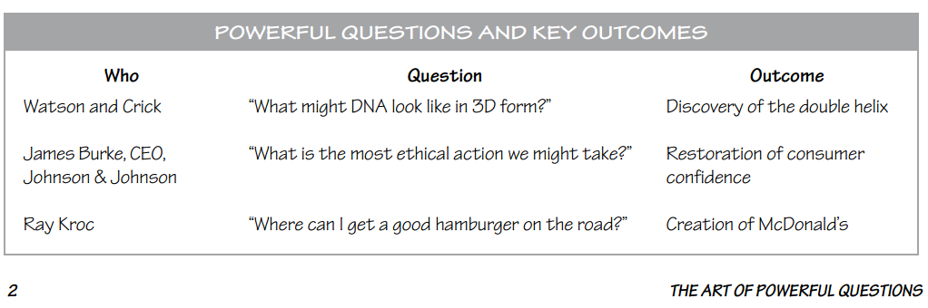
From the right answers to the right questions
Good questions lead to insights
Time for reflection

Slide 5
A Powerful Question
generates curiosity in the listener
stimulates reflective conversation
is thought-provoking
surfaces underlying assumptions
invites creativity and new possibilities
generates energy and forward movement
channels attention and focuses inquiry
stays with participants
touches a deep meaning
evokes more questions

Slide 6
DO’s
curiosity
reflection
reveal assumptions
creativity
energy
engagement
trust
meaningful
trigger more questions
DON’Ts
boredom
reaction
extend biases
agreement
stall
distraction
suspicion
trivial
dead-ends

Slide 7
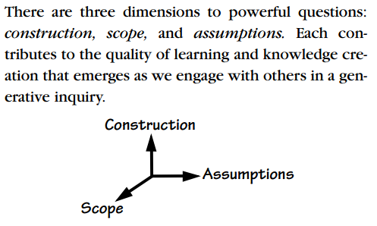

Slide 8

Construction, Scope and Assumptions
http://www.flickr.com/photos/dullhunk/202872717/sizes/l/

Slide 9
Construct Powerful Q’s
Different ways of asking the same question:
Are you satisfied with your job?
When have you been most satisfied with your job?
What do you find most satisfying about your job?
How may one define job satisfaction?
Why might it be that your job has its ups and downs?
(more reflective, engaging and deeper conversations)

Slide 10
Scope of Powerful Q’s
Different levels of asking the same question:
How satisfied are you with your job?
How would you personally define a satisfying job?
How may one define job satisfaction?
How may one possibly define happiness?
(balance insight, scope and relevance)

Slide 11
Assumptions of Powerful Q’s
Different assumptions behind the same question:
What can you do to improve your job satisfaction?
What can the company do to improve the job satisfaction of its employees?
How would new KPIs affect your job satisfaction?
How may job satisfaction impact life quality?
(implicit / explicit)

Slide 12

http://www.flickr.com/photos/mworrell/266913194/sizes/l/

Slide 13
Prepare background information
Plan goals, available time, history
Formulate questions
Write down different versions (construction, scope and assumptions)
Rate them in terms of power
Anticipate alternate interpretations (test)
Envision possible/potential responses (test more)
Develop and refine your own (your group) strategies, techniques and tips

Slide 14
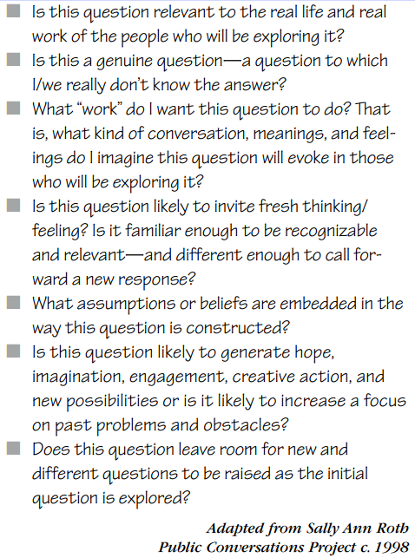

Slide 15

http://www.flickr.com/photos/a_ninjamonkey/3294014627/sizes/l/

Slide 16
Learn to listen
Practice, practice, practice
Take notes (figuratively or literally)
The best questions are not questions (interrogations)
Interviews are learning conversations

Slide 17
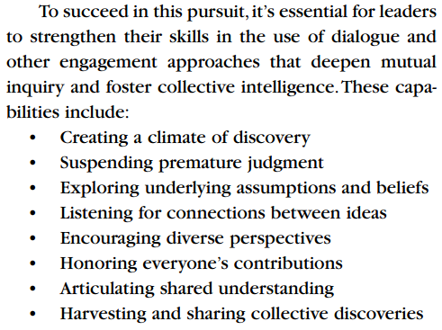

Slide 18

http://www.flickr.com/photos/86979666@N00/7623744452/sizes/l/

